Slide 1
Command Line Arguments

Slide 2
Command Line arguments are passed into the main function of a program when launched by the operating system.
They are most commonly used when executing programs from a console such as powershell or terminal.
Here g++ is the name of the program (C++ compiler) and main.cpp is an argument that will get passed into the g++!

Slide 3
The main function!
int main(int argc, char *argv[])
{
}
argc is the argument count. Note the name of the program is included in this count. The previous example (g++ main.cpp) has an argument count of 2
argv is an array of cstrings (null terminated strings)
The * and [] is what makes it an array of strings. To access the first element (the program’s name) you use argv[0]. Remember arrays are zero indexed.

Slide 4
Example Program
#include <iostream>
int main(int argc, char *argv[]){
std::cout << “argc =” << argc << std::endl;
// Prints out the command entered
for(int i = 0; i < argc; ++i)
{
std::cout << argv[i] << “ “;
}
std::cout << endl;
}
Here we print out every item using the index [i], one-by-one,
Until we reach the count, or the argc value

Slide 5
Closer look at main
int main(int argc, char* argv[])
{
// if there are arguments, write them
if (argc > 1)
{
for(int i = 0; i < argc; ++i) // write all but the last
{
cout << argv[i] << " "; // argv[i] is a char*
}
cout << argv[i] << endl; // write the last entry
}
return 0;
}
Here we print the name of the file, then everything else
Notes:
these can have arbitrary names, but programmers often call them argc and argv .

Slide 6
Closer look at main
int main(int argc, char** argv)
{
// if there are arguments, write them
if (argc > 1)
{
for(int i = 0; i < argc; ++i) // write all but the last
{
cout << argv[i] << " "; // argv[i] is a char*
}
cout << argv[i] << endl; // write the last entry
}
return 0;
}
The value of argv is a pointer to the initial element of an array of pointers, one for each argument.
The initial element of that array always represents the name by which the program is called, so argc is always at least 1.
The value of argc is the number of pointers in the array of which argv points to the initial element.
Notes:
Coded a little differently but here we are giving main two parameters: an int and a pointer to a pointer to char.

Slide 7
Closer look at main
int main(int argc, char* argv[])
{
// if there are arguments, write them
if (argc > 1)
{
for(int i = 0; i < argc; ++i) // write all but the last
{
cout << argv[i] << " "; // argv[i] is a char*
}
}
return 0;
}
If we compile this program and put the resulting executable in a file called say, then by asking the system to execute say Hello, world will result in this output:
Hello, world
Notes:
these can have arbitrary names, but programmers often call them argc and argv .

Slide 8
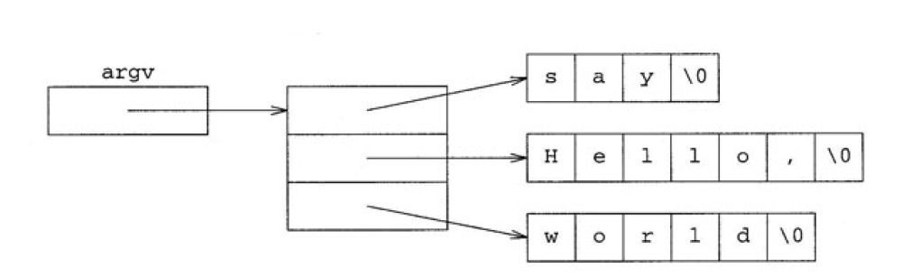
Closer look at main
int main(int argc, char* argv[])
{
// if there are arguments, write them
if (argc > 1)
{
for(int i = 0; i < argc; ++i) // write all but the last
{
cout << argv[i] << " "; // argv[i] is a char*
}
cout << argv[i] << endl; // write the last entry
}
return 0;
}
In this case, argc will be 3, and the three elements of argv will be pointers to the
initial characters of arrays initialized with say, Hello , and world respectively. We can visualize the value of argv this way
Notes:
these can have arbitrary names, but programmers often call them argc and argv .

Slide 9
IMPORTANT
Do not access an element outside the bounds of your array! That is why we have argc.
You do not pass in argc from the command line!

Slide 10
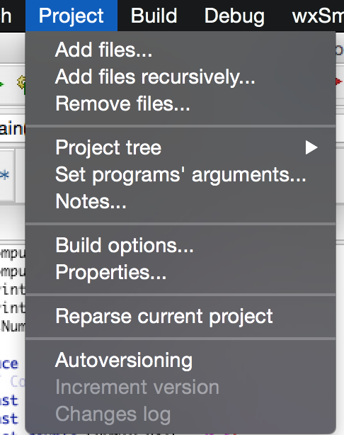
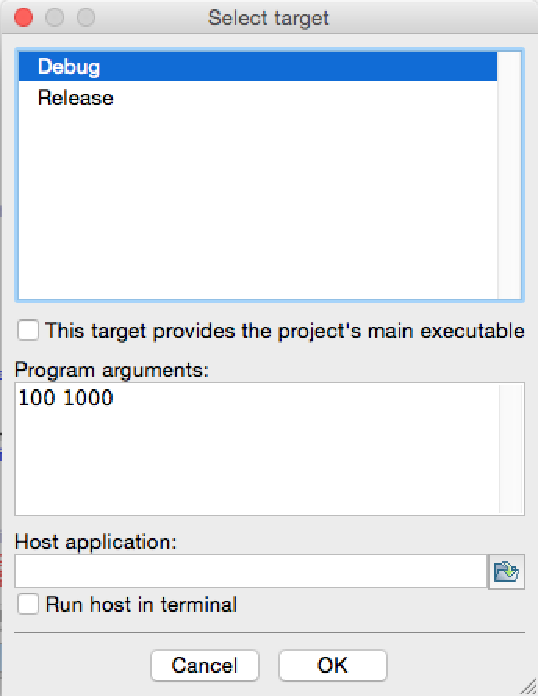
Set up command line arguments with Code::Blocks

Slide 11
Put all entities with linkage in implementation files.
You may have defined your unnamed NS as seen:
namespace {
// Constants
const double DEATH_RATE = 0.1;
const double CONVERSION_RATE = 0.00001;
const double GROWTH_RATE = 0.4;
const double WOLF_ABILITY = 0.0005;
const int CAPACITY = 30000;
const int ARRAY_SIZE = 101;
}

Slide 12
Put all entities with linkage in implementation files.
First, what is linkage?
linkage describes how names can or can not refer to the same entity throughout the whole program or a single translation unit.
We want same names in our project. We saw (or will see) pretty quickly how these names defined this way are not seen in our functions.
We’ll be tempted to recreate them in our header files. We then may encounter messages and cause link-time errors complaining of duplicate symbols… That’s because each source file actually defines and allocates space for them.
This causes bloat because they are repeated.

Slide 13
Put all entities with linkage in implementation files.
For our project (and for our future domination as extraordinary programmers) we will use the extern option, accompanied with a separate implementation file (.hpp)
Programmer’s use extern to extend the visibility. We will code them in main, as a forward declaration (here are the names that will be used later…)
Sadly, the unnamed NS will not work this way (but that’s okay).
This avoids having many copies by sharing these constants. We need to simply add the extern, and make a separate header file (see p3Constants) to hold only the variable forward declarations

Slide 14
Put all entities with linkage in implementation files.
And here is the updated NS now as seen:
namespace p3Constants
{
// Constants
extern const double DEATH_RATE = 0.1;
extern const double CONVERSION_RATE = 0.00001;
extern const double GROWTH_RATE = 0.4;
extern const double WOLF_ABILITY = 0.0005;
extern const int CAPACITY = 30000;
extern const int ARRAY_SIZE = 101;
}
Notes:
definitions go in a single implementation file. By default, const global variables have internal linkage. We use the extern keyword to explicitly make them external. Notice we initialize them here

Slide 15
Put all entities with linkage in implementation files.
A look inside of the p3Population function, we find the include for the constants (b/c it was the first to use them):
#ifndef p3Population_hpp
#define p3Population_hpp
// constants will get instantiated only once (in p3Constants.hpp),
// instead of once every time p3Constants.hpp is #included, and
// the other uses will simply refer to the version in p3WolfMoose.cpp.
#include "p3Constants.hpp"
using namespace p3Constants;
Notes:
definitions go in a single implementation file. By default, const global variables have internal linkage. We use the extern keyword to explicitly make them external. Notice we initialize them here

Slide 16
#ifndef p3Constants_hpp
#define p3Constants_hpp
// This header file is just for forward declarations of the variables.
// A forward declaration tells the compiler about the existence
// of these constants before actually defining them...
namespace p3Constants{
// Project 3 Constants
extern const double DEATH_RATE;
extern const double CONVERSION_RATE;
extern const double GROWTH_RATE;
extern const double WOLF_ABILITY;
extern const int CAPACITY;
extern const int ARRAY_SIZE;
}
#endif
Notes:
definitions go in a single implementation file.

